Slide 6
empower slides – content management for PowerPoint
Market Research – Use Cases – Feature Overview – Case Studies – IT Requirements – About Made in Office
Back to Overview

Slide 7
How empower slides is able to help your company
Sales enablement – optimally support your sales team
Consistently communicate your brand in every presentation
Increase user acceptance of your Corporate Design Relaunch
Free up more time for what is important
Ensure compliance to your corporate identity
Encourage collaboration and exchange of knowledge
Learn to love PowerPoint
Back to Overview

Slide 8
Our PowerPoint study in collaboration with the research firm GfK
“How much time per week on average
do you spend working with PowerPoint?”
“How much of this time do you
spend formatting?”
“How many presentations do not match the
prescribed brand presence?”
The complete survey can be downloaded for free: download the comprehensive PowerPoint study
Back to Overview

Slide 9
Use Cases & Feature Overview
Back to Overview

Slide 10
See empower slides in action in 2:30mins
Back to Overview

Slide 11
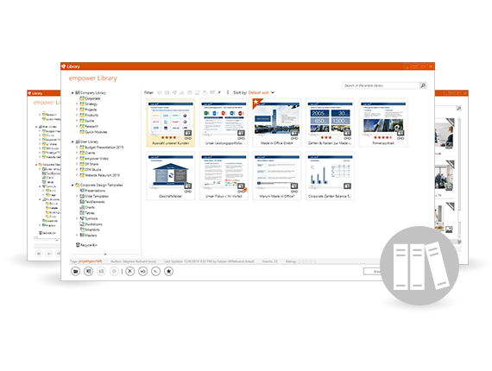
Provide slides companywide
Provide content
Make all important content available to your employees. All content is retrievable directly in PowerPoint – even via SharePoint connection and specialized iPad app.
Search content
Every one of your employees can utilize a Google-esque search to acquire relevant content which they can then easily add into their presentations.
Work offline
Employees always have access to all the content that they have permission to use – even on the road thanks to integrated offline mode or iPad app.
Update slides
You update slides and empower slides will ensure that these updates are distributed companywide. Users will receive update notifications when they open outdated content.
Manage languages Provide slides in multiple languages and empower slides will ensure that all translations are up to date. The user can then switch between different language versions.
Administer
It is easy to administer empower slides yourself thanks to bulk uploads, intelligent change detection and usage statistics.
Control access
Access in empower slides can be conveniently controlled on a folder level via active directory groups.
Collaboration
Multiple users are able to work on the same presentation simultaneously without the danger of data loss and back-and-forth emails.
Compliance
Compliance workflows, expiry dates and a complete version history enable clear understanding of changes.
Back to Overview

Slide 12
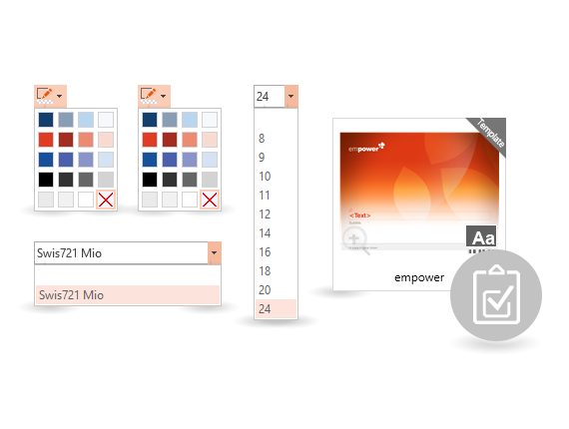
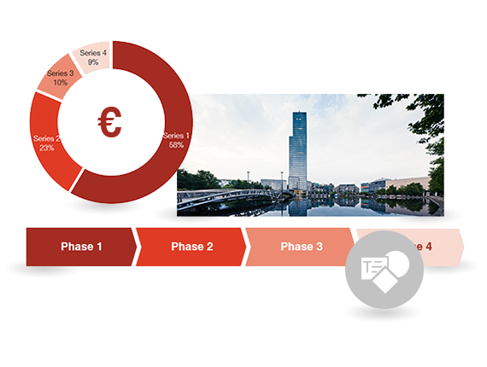
Create slides efficiently & brand compliant
Master templates
All masters are made directly available within PPT. Marketing can update them centrally with a single mouse click.
Create an agenda
Create an agenda at the click of a button that conforms to corporate design. With sub-points, page numbers and in any layout you wish.
Fonts & colors
empower slides only presents colors and fonts that are used in your corporate design. This way you work conform to CD – every time.
Pictures
Clicking on an image placeholder automatically opens your central image gallery optimized for PPT. You can also connect empower slides to your 3rd party DAM systems.
Slide templates
Choose from hundreds of pre-designed and CD-approved slide templates: no matter if your need a world map, organigram or value chain.
Diagrams
Create perfectly formatted diagrams with a single click or apply these styles to existing diagrams.
Texts & tables
Centrally define perfectly CD-approved text elements and tables which you can insert into your presentation with little effort.
Icons
Have an icon gallery at your fingertips with all the important icons for diagrams and infographics according to your PowerPoint requirements.
SmartArts
We create personalized SmartArts that behave in accordance to your corporate design.
Back to Overview

Slide 13
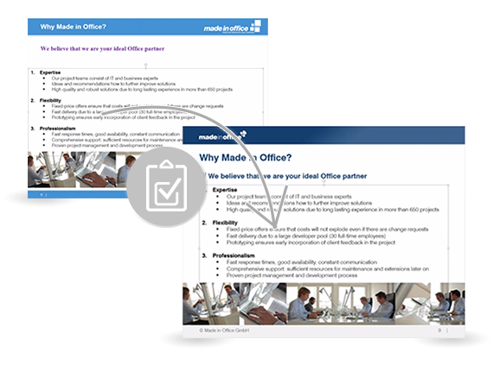
Revise existing slides
Design Check
Design Check examines and corrects master, fonts, colors, titles, numberings, margins and logo spacing to make everything conform to CD.
Layouts & footers
Removes unrequired layouts from the master and automatically corrects the footer.
Slide updates
Apply slide updates after you have revised existing slides. empower slides will highlight all available updates and you decide which ones to use.
4:3 <> 16:9 switch
Dynamically switch between 4:3, 16:9 and any other format you use. Distortion is eliminated and replaced with smart layout alignment.
Spell check
Check the spelling of your presentations by centrally setting the language.
Excel links
Update your slides with excel diagrams and tables via the link function.
Apply formats
Eliminate time consuming formatting by applying the format of existing objects to your own text elements and tables.
Layout tools
Create professional diagrams with the help of enhanced layout tools to align elements by a grid, automatic distribution and a position painter.
Status objects
If required you can change the appearance of traffic lights, harvey balls, etc. at the click of a button.
Back to Overview

Slide 14
Our roadmap by end of 2018
Completely overhauled architecture with following improvements::
Massively enhanced performance of complete application
Reduced network load due to scalable service architecture
Offline mode also allows saving & co.
Detailed view in library
Automatic slide translation with Google Translate
Connection to SharePoint sites, network drives, OneDrive, Dropbox und Box-drives with intelligent search function on the slide level
Development of Office application with basic functionality in browser, iOS, MacOS and Android
Development of browser version for cross-platform access to the library on any device.
expected Q2/2018
Q3/2018
Q4/2018
Back to Overview

Slide 15
References & Case Studies
Back to Overview

Slide 16
A selection of our empower slides customers
Back to Overview

Slide 17
Sales Enablement
How to align the global sales force with your headquarters
Siemens Industry had the challenge to provide easy access to all available PowerPoint sales materials to its 10,000 user global salesforce. Slides were updated frequently and the sales people on the road were to never present outdated information.
Global Slide Management with empower slides
Siemens Industry introduced empower slides in 2014. Today, Siemens stores more than half a million slides in approx. 5,000 presentations in their central library. With cutting edge update technology, all employees receive updates immediately with full access to all content even when working offline.
empower is an important add-in that significantly increases our PowerPoint productivity with a high-performing enterprise-level architecture.
Thomas Rubach, Head of Information Management
“
Back to Overview

Slide 18
Productivity and Compliance
PowerPoint in the financial industry
As with all companies in the financial industry, S&P creates a massive amount of content using PowerPoint. No matter whether it is internal or external documents, PowerPoint is the means for presenting this content. S&P wanted to reduce the time spent on creating presentations as well as ensuring compliance and review paths for all changes. In particular, typical tasks like creating and updating tables of contents, applying table and chart styles to Excel-based data and using a slide library were required to make the company-wide creation and management of content more efficient.
30% time saved with empower slides
S&P conducted a global research to find the best PowerPoint solution available. After extensive research and due diligence, they decided to implement empower slides. Since then, the productivity of the users has gone up by 30% on average, freeing up a significant amount of time that now can be used for more important tasks like the analysis and conclusions.
From our perspective, we have always thought of Made in Office and the work they do as the “gold standard” of how products should be developed. Made in Office is innovative, reliable, experts in Office plug-ins, and incredibly hard working.
Alyssa Le, VP Business Development
“
Back to Overview

Slide 19
Brand Communication
Corporate Design Relaunch in 2014
Continental AG is one of the world’s largest suppliers in the automotive industry. When Continental modernized its brand in 2014, their big challenge was migrating millions of existing presentations from the old to the new design. In addition, after investing so much money in rebranding, they asked themselves how they could empower slides their employees to always create consistent presentations according to their brand.
Brand consistency increased threefold with empower slides
Continental introduced empower slides company-wide to all 80,000 users globally. Not only could they quickly migrate old slides to the new design with the cutting edge corporate design check, but they also ensured that all users have direct access to the new template, the valid corporate design colors and fonts and all corporate images and icons. This enabled the entire organization to live and breathe their brand in every presentation.
With empower we have significantly improved the consistency of our brand communication without significant investments in our IT infrastructure.
Thomas Röhrich, Head of Brand Communications
“
Back to Overview

Slide 20
IT Requirements
Back to Overview

Slide 21
Technical requirements
Supported Office versions
Server requirements for empower slides professional
Office 2007
Office 2010
Office 2013
Office 2016
Office for mac is not supported yet, but a virtualization / remote apps / Citrix is already possible
Network drive or
OneDrive or
Dropbox
Supported operating systems
Server requiremens for empower slides enterprise / library
Windows XP
Windows Vista
Windows 7
Windows 8
Windows 10
Terminal-Server
Citrix
SQL Server 2008 or higher
or hosting via Microsoft Azure in our empower slides Cloud
Optional connection to SharePoint and other systems such as CRM, PIMS, DAMS
Back to Overview

Slide 22
Which empower slides edition is right for you?
empower slides professional
empower slides library
empower slides enterprise
Installation on a network drive without IT admin rights possible
Tools for the efficient creation of new slides
Tools to ensure CD conformity
Central slide library with reusable content
Varying user permissions per folder & directly manageable
Simultaneous work on presentation with multiple users
iPad app, user statistics, favorites, ratings
Installation on a scalable SQL server database
Back to Overview

Slide 23
About Made in Office
Back to Overview

Slide 24
Facts & Figures
#1
Leader in the field of Office programming
50
Full-time employees
5
Locations in Germany, USA, France, England and Switzerland
930.000
empower slides users worldwide
>220
empower slides customers worldwide
2005
founded
Back to Overview

Slide 25
Our Locations
Made in Office GmbH
Im Mediapark 8
50670 Köln
+49 221 99 37 85 77
Made in Office UK
41 Wardour Street
London W1F 0UT
+44 7946 504 977
Folienwerke GmbH (Partner)
Zollikerstraße 153
8008 Zürich
+41 44 578 44 84
Made in Office US
80 Broad Street
New York, NY 10004
1-800-657-0270
Made in Office France
3B Rue Taylor, CS 20004,
75481 PARIS CEDEX 10 Paris
+33 (0)1 84 88 01 70
Contact us to discuss your requirements, learn about pricing and schedule an online demo.
Back to Overview

Slide 26
Back to Overview

Slide 27
empower® charts – Complex charts. Effortlessly created.
Back to Overview

Slide 28
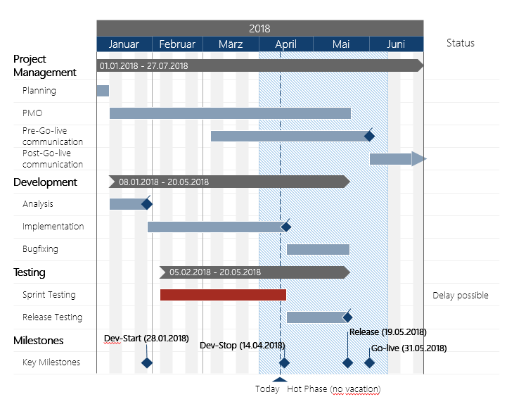
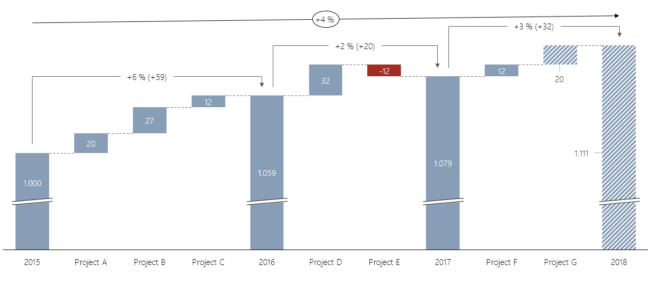
Visualize complexity
Gantt and waterfall: our dream team in terms of clear visualization
Use empower® charts for the planning and reporting of projects: Gantt charts allow you easily display activities and milestones on a timeline. You can also use Gantt waterfall charts to display steps in bar charts. Growth indicators as well as the necessity of economization are clearly and comprehensibly emphasized.
Functions:
Gantt charts
Flexible adjustment of timelines
Visualizations (milestones, emphasis, etc.)
Integrated and expandable vacation calendar
Waterfall charts
Display of any Increase and decrease possible
Calculation of (sub)totals
Back to Overview

Slide 29
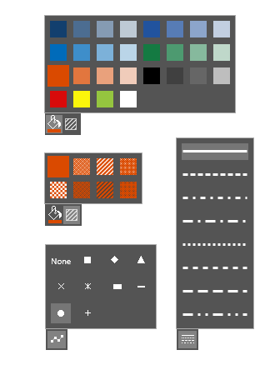
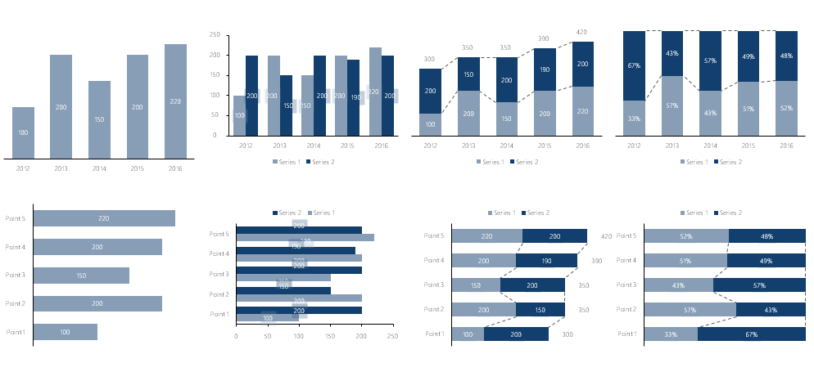
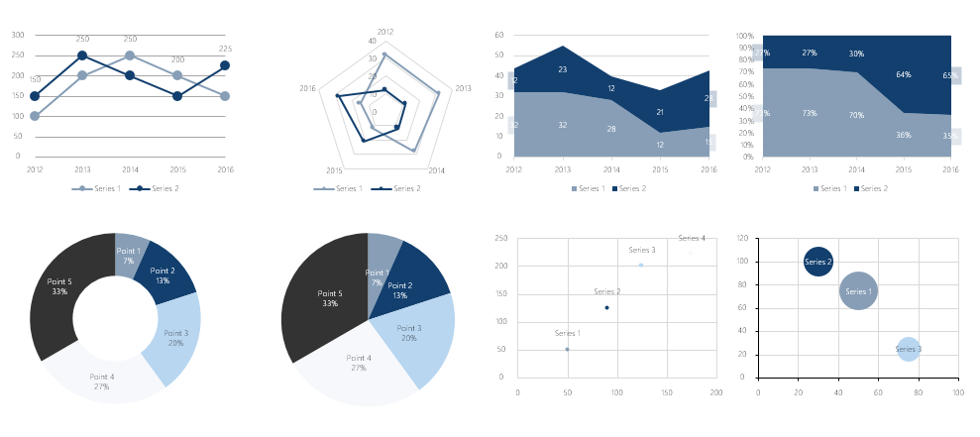
Uniform design
The star in every chart: your brand
empower® charts not only creates elegant charts, they conform to your brand 100%. During initial setup we will adapt all your charts types to be completely in line with your corporate design. During this phase we work closely with you to ensure that every detail is just right. You want to change something later? No problem: all settings can be centrally adjusted. All users also have the ability to set individual formatting, only within the corporate design guidelines. This way you brand always takes center-stage – even in charts.
Functions:
All charts conform to corporate design
Restricted fonts and font sizes
You corporate design fill and line colors
Only approved symbols and lines
Settings are administered centrally
Back to Overview

Slide 30
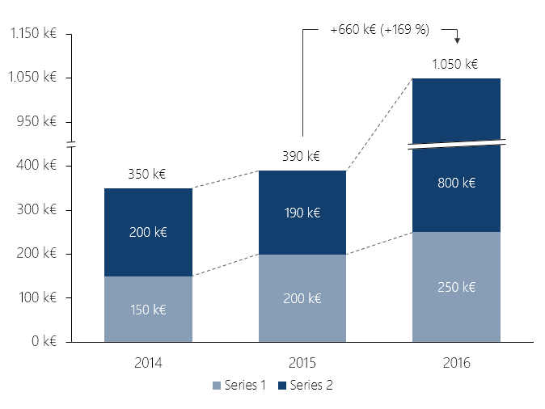
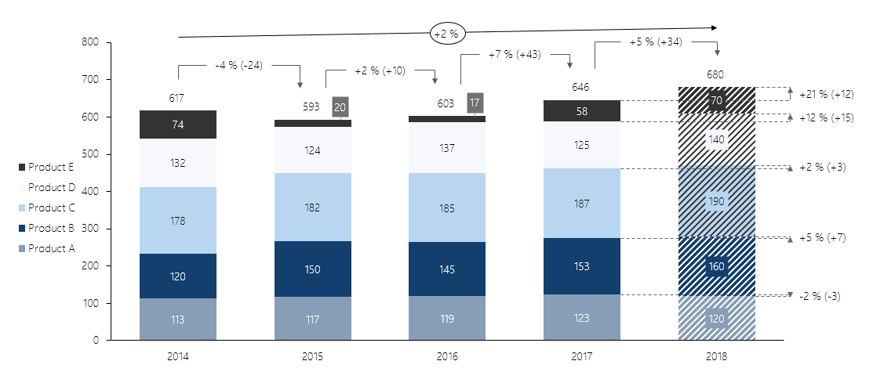
Work efficiently
Break the limits: create charts with arrows, breaks and Excel links
Frequently users miss a special something when working with PowerPoint – easy to use additional functions the presentation with a bit more oomph. Have you already tried to display absolute growth or the annual average (CAGR) with an arrow? No problem with empower® charts. Inserting breaks to reduce optical breakaways as well as the formatting of numbers are a breeze with a few clicks. A further highlight: charts can be directly linked to Excel tables.
Functions:
Stacked / grouped column/bar charts
Line charts
Dot and bubble charts
Pie charts
Area charts
100% chart mode
Combined charts
Growth, delta and CAGR arrows
Connection and value lines
Breaks
Column totals
Comprehensive number formatting
Comprehensive chart formatting
Excel links
Back to Overview

Slide 31
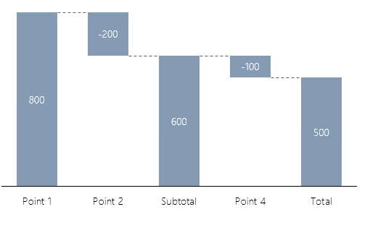
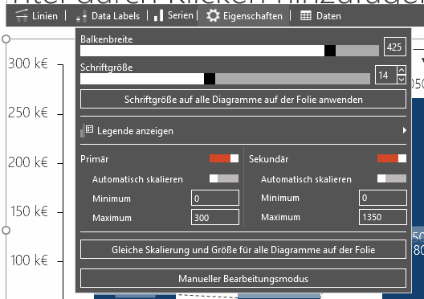
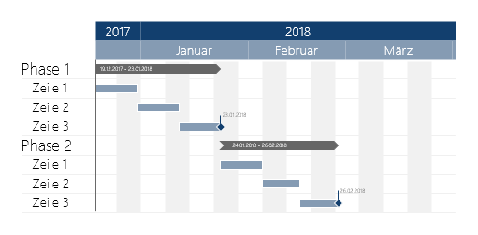
Advantages of empower® charts vs. PowerPoint charts
Addition of essential chart types
Arrows, lines and number formats
Easy and uniform charts
empower® charts offer users the two essential chart types that are not natively supported by PowerPoint: Waterfall and Gantt chart.
Users frequently want to display growth, CAGR, average, delta and benchmark lines. They also want to use specific number formats. empower® charts provides all these functions with just a click of a button.
empower® charts enables users to create perfectly designed charts that comply with corporate design standards. Further all relevant chart settings: bar totals, bar width, font size, etc. are in direct access. In native charts these settings are absent or hard to find.
Back to Overview

Slide 32
Advantages of empower® charts vs. other chart solutions
1
2
3
4
5
Save time adjusting
Profit two-fold thanks to native PPT charts
Intuitive & easy to use
Uniform charts in your corporate design
Significantly more cost-effective
empower® charts are based on native PPT charts. Charts can therefore be inserted into placeholder with no issues.
PPT-layout changes are therefore possible with the click of a button
Charts do not extend beyond the slide or drawing area when adding arrows or data arrays.
Users save time with easy to use features and slides look more professional.
Due to the fact that empower® charts are based on native Office charts, the user has two key advantages:
Created charts can at the very least be manually adjusted on all MS Office systems.
You don’t only benefit from the ongoing development of empower® charts but also from Microsoft Office feature updates.
Using empower® charts is simple and intuitive.
Other solutions are more complex to use or provide a multitude of settings that the average users would never need.
No bloatware - empower® charts focuses on the essentials and offers its functions in a clear and logical layout.
Users save valuable time and can instantly begin working on the things that matter.
empower® charts allows you to centrally define the look of all charts, colors and elements.
The design of charts is uniform throughout the company – just the way corporate design defines it.
Other solutions require the individual user to set the design of their charts resulting in wasted time and non-uniform slides.
Compared to similar solutions empower® charts is significantly more cost-effective.
This is due to the fact that many users seldom create charts.
A lower priced tool will enable a more economic distribution to power and occasional users of the software.
Our license model allows savings on your current charting licensing fees of up to 50-75%.
Back to Overview

Slide 33
Back to Overview

Slide 34
empower docs for Microsoft Word
Back to Overview

Slide 35
Why empower docs?
01
Back to Overview

Slide 36
What is empower docs?
empower docs Ribbon
empower docs is a fully integrated Content Management System that sits in the Word Ribbon-menu (see the background image).
empower docs allows users in a company to quickly create uniform documents and access common knowledge sources.
With integrated company information, empower docs ensures compliance with legal requirements.
empower docs is part of a holistic product Suite for Microsoft Office that enables efficient and cross-program work in PowerPoint, Excel, Word and Outlook.
Back to Overview

Slide 37
Create quickly legally correct documents
Current situation
The benefits of empower docs
Many employees work intensively with Word.
Departments are asking for supporting tools to facilitate document management and production.
Templates and text elements are not easily accessible.
Legally relevant or general information is only provided or communicated with a delay.
Document uniformity leaves something to be desired and does not comply with the Corporate Design guidelines.
empower docs from Made in Office is used worldwide by well-known companies and consultations, e.g. at Continental and Schaeffler.
empower docs provides tools for more efficient document creation, better management of templates and the direct integration of site, user and customer information.
With empower docs, you ensure that every employee can always access legally correct and uniform templates.
empower docs is continuously developed by a 40-strong team in close cooperation with Microsoft and will also support Office Online and Mac OS in future.
Back to Overview

Slide 38
How empower docs helps your company
No longer searching for the right templates
Always all templates available offline
Automatic entry of your own sender data in each template
Easily insert the address data from all Outlook contacts
Insert predefined text blocks directly into the documents
Show or hide logos at any time
Always the legally correct information in the footer
Back to Overview

Slide 39
Functional Overview
02
Back to Overview

Slide 40
Functionality of empower docs
Central template management
Provision of all Word templates from one location
Advanced user rights concept
multilingualism
Automatic offline synchronization
Profiles & Locations
Automatic entry of sender information with own profile
Select other senders as needed
Management and use of multiple site identifiers and legal forms
Adress data
Directly insert Outlook contacts or other sources into any document
Central text element administration
Predefined, central text blocks to insert
Text blocks can also contain images, tables, and diagrams
Show or hide your stationery
Logo and header and footer can be dynamically displayed and dimmed
Manage footer information
Central administration of all footer data
Automatically update footer data
Restricted formatting tools
E.g. Fonts, sizes and colors
Locked format templates
Back to Overview

Slide 41
Every template available anytime & anywhere
Direct integration into Word
Central maintenance and administration of all templates
Updating message with intermediate update
Any complex file structure is definable
Multilingualism
Available Offline
Your own user library
User rights (Active Directory) control who can use which templates for use or editing
Back to Overview

Slide 42
Change template language with one click
Back to Overview

Slide 43
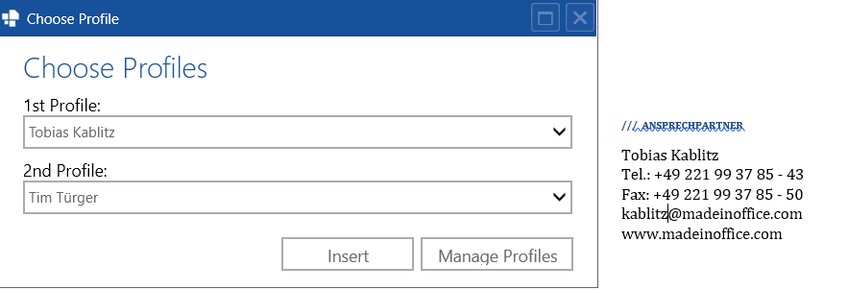
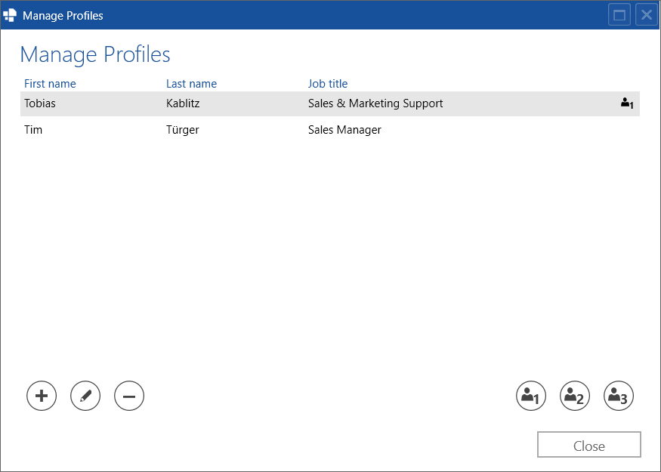
Directly select, manage and use sender profiles
Direct integration of your (default) profiles into Word
Default location for users
Up to 3 profiles per document is possible
User profiles are taken directly from Active Directory
Additions and translation possible
Secretarial service - Write in behalf of third parties
Effortlessly add more profiles
Back to Overview

Slide 44
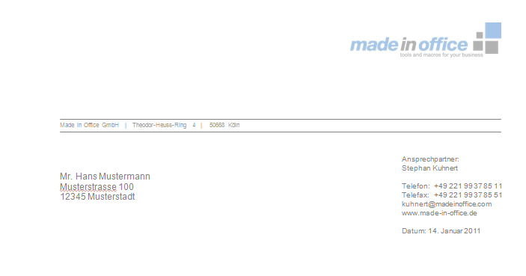
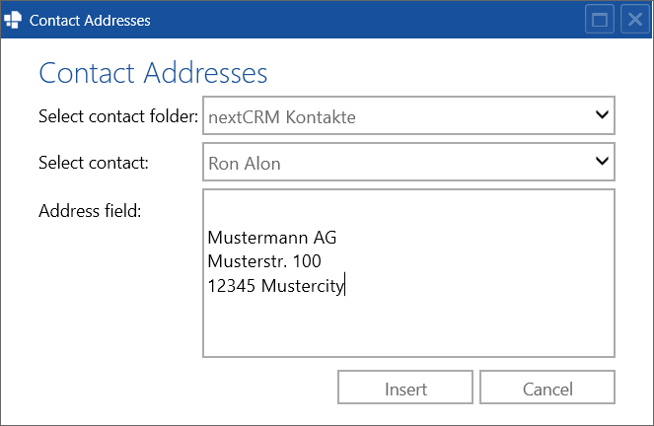
Easily insert address data from Outlook
Access the contact data directly from your Outlook
Integration into defined placeholders
The integration of other address data databases is possible at any time in the context of an individual extension
Back to Overview

Slide 45
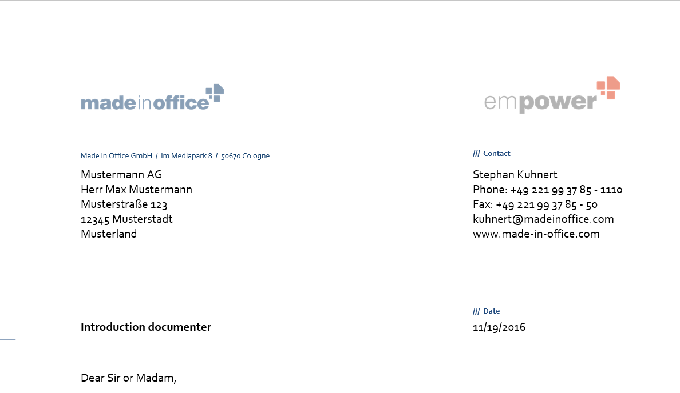
Show and hide the stationery and logo
If you want to print the stationery easily (for example, header and footer)
When sending as a PDF file (e-mail attachment) simply activate the header and footer display
You can also define and temporarily use additional logos (for example, in sponsoring actions)
Complement your company logo by location or language
Back to Overview

Slide 46
Central text blocks available in every document
Central maintenance of text modules, which can be used independently of the template
Storage of further document elements, such as tables, diagrams, icons, and images
Available offline
User rights (Active Directory) control who has which rights
Any complex file structure is definable
Own (shareable) user library
Back to Overview

Slide 47
Automatically update old footer information
Via a central footer management, different company names and different locations (and logo) can be maintained per company.
The number of templates to be maintained can be reduced to a minimum as all data from the central administration are inserted.
Changes can be centrally maintained and automatically set for all templates.
Besides location information, additional data can also be integrated and managed:
Management team members
Bank compound(s)
Legal information
Back to Overview

Slide 48
Your corporate design directly in Word
Reduced fonts
Reduced font sizes
Reduced font colors
!
Provide your users with direct, compliant selection options!
Back to Overview

Slide 49
Locked templates ensure corporate design compliance
Back to Overview

Slide 50
technical requirements
03
Back to Overview

Slide 51
Architecture at empower docs
Architecture
Description
empower docs is a client-server application.
A Word plug-in is installed on each client (the offline sync process is part of the installation).
Offline synchronization regularly checks whether new content is available on the SQL server. The adjustment takes place in the background.
Back to Overview

Slide 52
Technical requirements
Supported Office versions
Server requirements for empower docs
Office 2007
Office 2010
Office 2013
Office 2016
Office for mac is not supported yet, but a virtualization / remote apps / Citrix is already possible
SQL Server 2008 or higher
or hosting via Microsoft Azure in our empower Cloud
Optional connection to SharePoint and other systems such as CRM, PIMS, DAMS
Supported operating systems
Available Languages (Multi-Language Support)
Windows XP
Windows Vista
Windows 7
Windows 8
Windows 10
Terminal-Server
Citrix
English
Spanish
French
Chinese
Japanese
German
Russian
Italian
Portuguese
Other languages on request
Back to Overview

Slide 53
References
04
Back to Overview

Slide 54
empower docs is a scalable solution for global companies
Selected References:
80.000
Users in 20 countries
50.000
Users in 42 countries
5.000
Users in Germany
2.000
Users in 19 countries
1.000
Users in 14 countries
Back to Overview

Slide 55
About Made in Office
05
Back to Overview

Slide 56
Facts & Figures
#1
Market leader in sector of Office development
50
Permanent employees
5
Locations in Germany, USA, France, England, and Switzerland
930.000
Users worldwide
>1.500
Global clients
2005
Founded
Back to Overview

Slide 57
Our Locations
Made in Office GmbH
Im Mediapark 8
50670 Köln
+49 221 99 37 85 77
Made in Office UK
41 Wardour Street
London W1F 0UT
+44 7946 504 977
Folienwerke GmbH (Partner)
Zollikerstraße 153
8008 Zürich
+41 44 578 44 84
Made in Office US
80 Broad Street
New York, NY 10004
1-800-657-0270
Made in Office France
3B Rue Taylor, CS 20004,
75481 PARIS CEDEX 10 Paris
+33 (0)1 84 88 01 70
Contact us to discuss your requirements, learn about pricing and schedule an online demo.
Back to Overview

Slide 58
Back to Overview

Slide 59
100% corporate design conformity in every email
Why – Functions – Roadmap
Back to Overview

Slide 60
Why empower mails?
Corporate design in Outlook? No chance!
Emails are the #1 form of communication in companies. According to our Office survey conducted in cooperation with the GfK, an employee sends an average of 7.000 emails a year. If, however, the signature is not set up correctly or font and colors do not conform to the brand‘s design, this brand is falsely communicated 7.000 times within a year – potentially by every single employee!
100% corporate design conformity in every email with empower
empower allows companies to centrally set that every employee is required to use the correct signature, as well as ensure that every email is uniformly formatted in concordance with corporate design.
Reinforce branding and save time
You are able to improve the communication of your brand while enabling time saving work with Outlook for your employees in their day-to-day business.
Back to Overview

Slide 61
Functions of empower mails by end of 2017
Central signature management
Automatic setup of a signature upon each startup
The user can set multiple signatures in several languages
The user is able to import their data from the Active Directory, as well as overwrite them if required
Changes to the central signature template are synchronized with all clients.
The user has the ability to use the signature of another colleague for delegated correspondences or substitutions
All information connected to the company, its location and legal information is accessed from a central empower database. Changes to this data are automatically synchronized with all clients
Corporate design
settings
Email settings (font, size, and color) can be centrally defined and synchronized with all clients.
Back to Overview

Slide 62
Roadmap 2018+
Font and color picker that conform to corporate design
Text element management for distribution of frequently used text, and mail templates incl. attachments
Out of Office Assistant to quickly set up uniform absence notifications
Google Translate support to quickly translate emails
Mail series function
Time management assistant for optimized inbox and task management
Back to Overview

Slide 63
Back to Overview

